Slide 1
Assignment 2
Lexical analysis

Slide 2
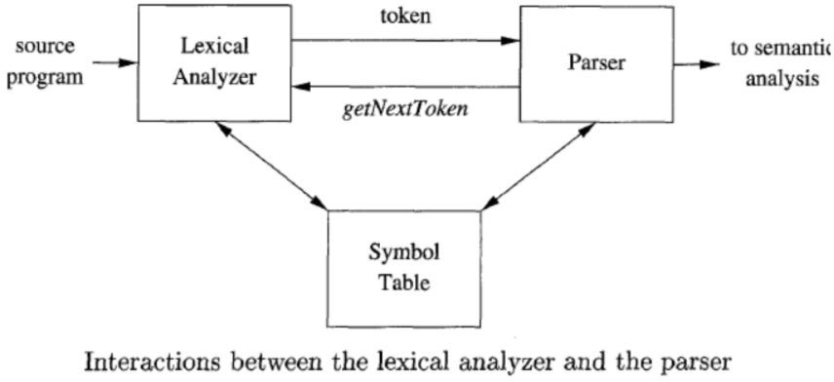
Lexical Analysis
Lexical Analysis is the first phase of compiler
Converts sequence of characters (source program) into a sequence of tokens
Used by the parser in the next stage to build an abstract syntax tree
Assignment 3 & 4

Slide 3
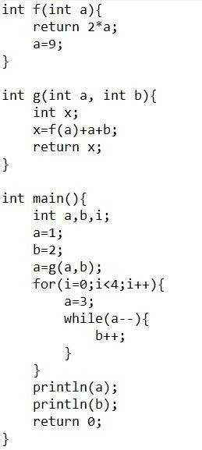
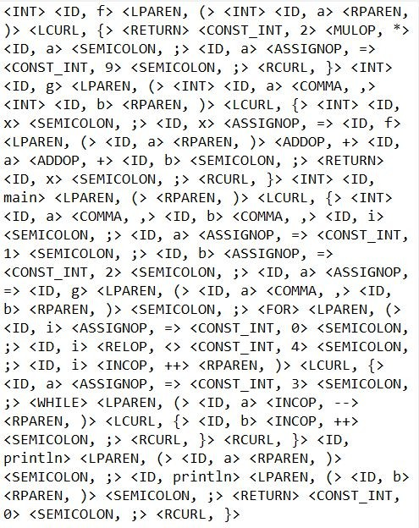

Slide 4
Character stream
Tokens

Slide 5
Lexical Analysis
Remove white spaces and comments
int main(){
// detects even numbers
int x=2;
if(x%2==0){
printf(“even”);
}
}

Slide 6
Lexical Analysis
Identify lexemes and generate tokens
<KEYWORD,int> <ID,main> <LPAREN> <RPAREN> <LCURL><KEYWORD,int> <ID,x> <ASSIGN,=> <NUM,2> <SEMICOLON,;> <KEYWORD,if> <LPAREN> <ID,x> <MOD,%> <NUM,2> <EQ> <NUM,0> <RPAREN> <RPAREN>
<ID,printf> <LPAREN> <STRING,"even"> <RPAREN> <SEMICOLON,;> <RCURL> <RCURL>
int main(){
// detects even numbers
int x=2;
if(x%2==0){
printf(“even”);
}
}

Slide 7
Lexical Analysis
Also interacts with the symbol table (e.g. store information about identifiers etc.)
<KEYWORD,int> <ID,main> <LPAREN> <RPAREN> <LCURL><KEYWORD,int> <ID,x> <ASSIGN,=> <NUM,2> <SEMICOLON,;> <KEYWORD,if> <LPAREN> <ID,x> <MOD,%> <NUM,2> <EQ> <NUM,0> <RPAREN> <RPAREN>
<ID,printf> <LPAREN> <STRING,"even"> <RPAREN> <SEMICOLON,;> <RCURL> <RCURL>
int main(){
// detects even numbers
int x=2;
if(x%2==0){
printf(“even”);
}
}

Slide 8
Lexical Analysis
Also interacts with the symbol table (e.g. store information about identifiers etc.)
<KEYWORD,int> <ID,main> <LPAREN> <RPAREN> <LCURL><KEYWORD,int> <ID,x> <ASSIGN,=> <NUM,2> <SEMICOLON,;> <KEYWORD,if> <LPAREN> <ID,x> <MOD,%> <NUM,2> <EQ> <NUM,0> <RPAREN> <RPAREN>
<ID,printf> <LPAREN> <STRING,"even"> <RPAREN> <SEMICOLON,;> <RCURL> <RCURL>
int main(){
// detects even numbers
int x=2;
if(x%2==0){
printf(“even”);
}
}

Slide 9
Lexical Analysis
Also interacts with the symbol table (e.g. store information about identifiers etc.)
<KEYWORD,int> <ID,main> <LPAREN> <RPAREN> <LCURL><KEYWORD,int> <ID,x> <ASSIGN,=> <NUM,2> <SEMICOLON,;> <KEYWORD,if> <LPAREN> <ID,x> <MOD,%> <NUM,2> <EQ> <NUM,0> <RPAREN> <RPAREN>
<ID,printf> <LPAREN> <STRING,"even"> <RPAREN> <SEMICOLON,;> <RCURL> <RCURL>
int main(){
// detects even numbers
int x=2;
if(x%2==0){
printf(“even”);
}
}

Slide 10
Lexical Error
Generates error with line no.
int main(){
// detects even numbers
int x=2;
float y=1.2.3;
if(x%2==0){
printf(“even”);
}
}

Slide 11
Errors
Lexical error
Syntax error
Semantic error
int main(){
// detects even numbers
int x=2;
if(x%2.2==0){
printf(“even”);
}
}
int main(){
// detects even numbers
int x=2;
fi(x%2.2==0){
printf(“even”);
}
}

Slide 13
Introduction to Flex
Flex is a tool to generate the lexer so that we do not have to build one from scratch
Free, open source
sudo apt-get update
sudo apt-get install flex

Slide 14
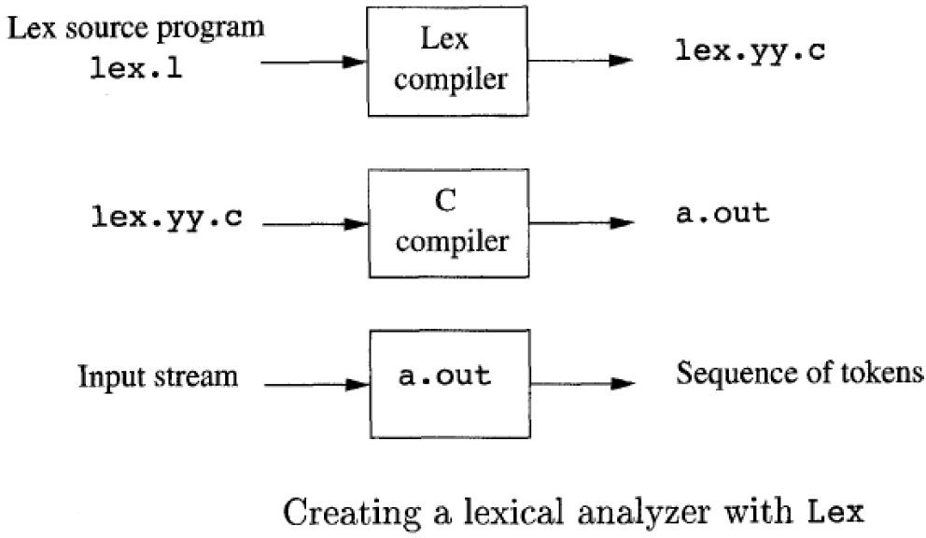
Introduction to Flex

Slide 15
Lex file (.l)
Example code : wordcount.l
3 Parts : separated by %%
Definition section
Rules section
Subroutine section
Definition section contains option settings, declaration of start states and variables (to be used in the rules section), and some C codes
In the declaration section, code inside of %{ and %} is copied through verbatim near the beginning of the generated C source file.
Include libraries for C code
Declare C variables and define functions to be used in the action part of the rules section

Slide 16
Lex File Divisions
Rules section contains regular expression/pattern to be matched and corresponding action (C++ code) to be taken if the expression is matched
One or more lines of code in braces
Each pattern must start at the beginning of the line (no spaces)
Flex considers any line that starts with whitespaces as code to be copied into the C program
Subroutine section contains C code to be copied to the lex.yy.c file
Usually contains the main function
Calls yylex() , that is the flex’s scanner routine.
Point yyin to the input file you are trying to scan (by default yyin is set to stdin).

Slide 17
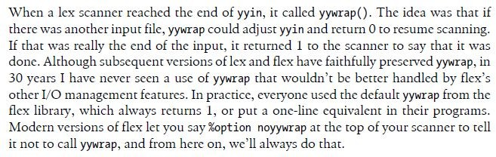
Definition Section
%option Provides some options: noyywrap, yylineno, nodefault etc.
%option noyywrap (TLDR: Just put it and don’t worry about anything else)
yylineno keeps track of the no. of lines (set yylineno=1 before yylex())
nodefault tells it not to add a default rule in case input does not match any pattern (not needed).

Slide 18
Definition Section
You can declare named subpatterns (names for corresponding subpatterns) in the declaration section.
Then in that way you can use the name (in curly braces) instead of the subpattern while you are writing patterns in the rules section.
Example: Letter in wordcount.l

Slide 19
Rules Section
In the rules section you can declare regular expressions to match complex patterns in the input file
Detect lexeme and generate token in the action section
Each pattern must start at the beginning of the line (no spaces).
The pattern is followed by action section (one or more lines of C++ code in curly braces) that tells it what to do when a pattern is matched
The matched expression from the input file is stored in the yytext variable.
You can also use the variables declared in the declaration section ( named subpatterns in curly braces in the regex part, and declared C++ variables declared in the code part ).
You can also declare C++ variables inside the action part too.
Each call of yylex() continues to match inputs until it returns from one of the action codes corresponding to a pattern matched
You will not be returning anything from the action codes in this assignment, so it parses through the whole file.

Slide 20
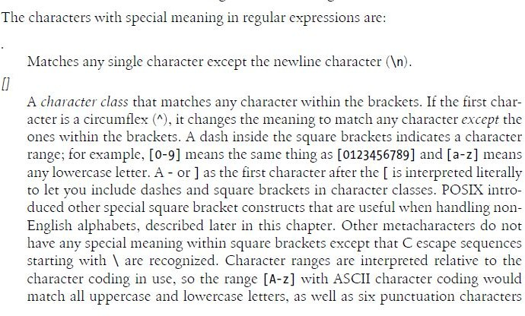
Special Characters

Slide 21
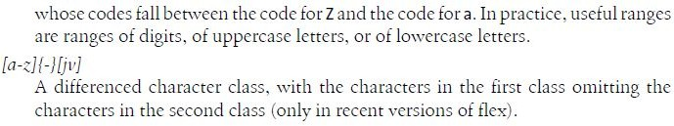
Special Characters
[a-zA-Z]
[^\t\v]

Slide 22
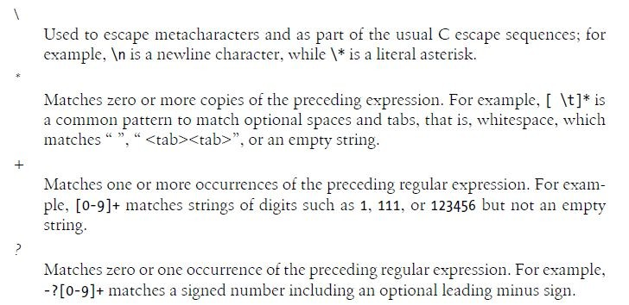
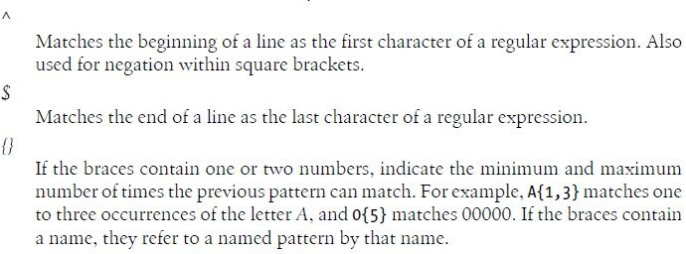
Special Characters

Slide 23
Special Characters
^r : An r, but only at the beginning of a line (i.e., which just starting to scan, or right after a newline has been scanned).
r$ : an r, but only at the end of a line (i.e., just before a newline). Equivalent to "r/\n"
{Letter}+
Letter [a-zA-Z] declared in declaration section

Slide 24
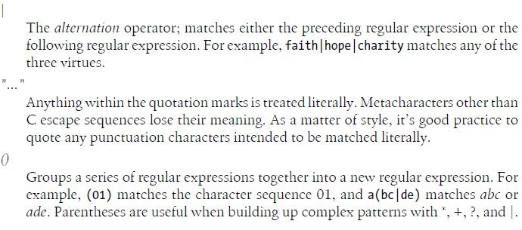
Special Characters
"[xyz]\"foo" : the literal string [xyz]“foo

Slide 25
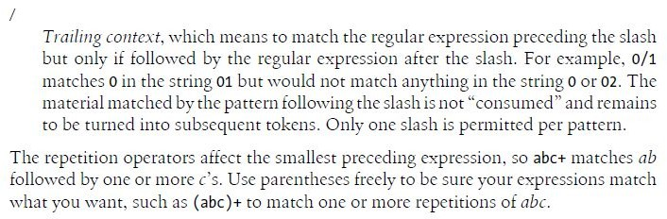
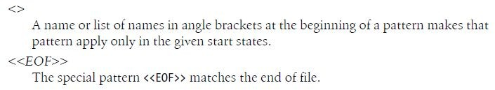
Special Characters

Slide 26
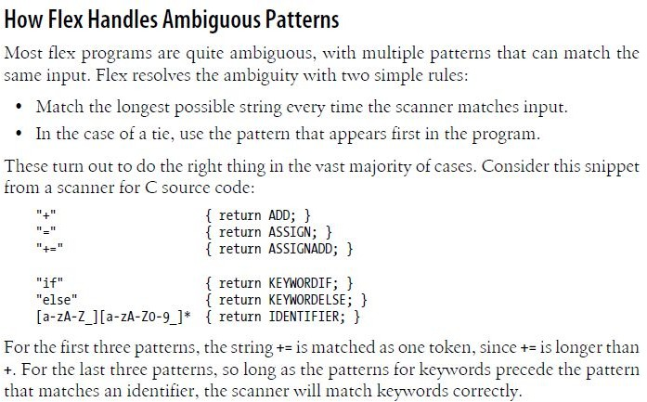
Ambiguous Patterns

Slide 27
Start States
Used when you are trying to match certain patterns only under certain contexts.
Controls which patterns can be matched when.
At any point, the scanner is in one start state and can match patterns active in that start state only.
You can define as many start states as needed.
Example: state.l
%x means an exclusive start state, which means that when that state is active, only patterns specifically marked with the state can match.
We can also define inclusive start states with %s, which means patterns not marked with any state can also match
%x MYSTATE defines a start state

Slide 28
Start States
Flex itself defines the INITIAL state, the state in which you are initially.
To switch to a different state in the action code, you must use the macro
BEGIN
BEGIN MYSTATE
Also make sure to return back to INITIAL state once your state related works are done (BEGIN INITIAL).
Patterns are tagged with start-state names in angle brackets to indicate in which state(s) the pattern is active.
The nameless patterns are active in the INITIAL state and any other inclusive state.

Slide 29
Assignment : Important Notes
Integrating the symbol table
Use your symbol table program of the first assignment.
Include as a header file (.cpp or .h) in the definition section.
Remove all the console I/O and file I/O done in the first assignment, remove its main function too.
You can write code in it to output in the log file (discussed later) .
Declare a symbol-table object to use in the action codes
Declare other C functions and variables you need to use in the %{ … %} part of the declaration section
Declare start states and any named subpatterns you need in the declaration section.

Slide 30
Assignment : Important Notes
Be careful about the order in which you write the rules
Remember how flex handles ambiguity
While generating patterns , beware you regular expression
Should capture all input it is intended to catch
Should not capture any input it is not intended to catch.
Character Literals:
Suppose you are reading the character literal ‘\n’
You will read ‘ , then \ and then n. (will not read enter). But as a token you have to say enter , again in the log file you have to print \ and n (not enter).
Also be careful about ‘\\’
While detecting multi-character literal error, make sure special characters like ‘\n’, ‘\\’ etc. don’t get interpreted as an error.

Slide 31
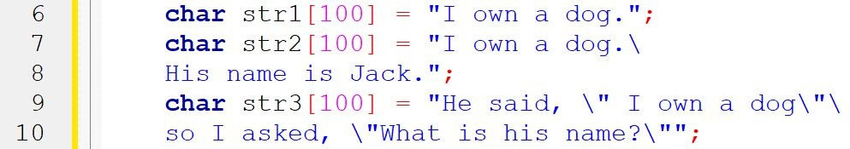
Assignment : Important Notes
String literals

Slide 32
Assignment : Important Notes
Special characters like ‘\a’ , ‘\b’ can also be inside the strings.
Carefully distinguish between errors and what is correct, also properly extract and print the lexeme in the log file and token attribute in the token file (sample 1).
Ensure the scanning continues to run properly even after detecting such complex strings.
Depending on the C compiler in use and the OS, newlines could be ‘\n’ or ‘\r\n’. Handle
those properly.
25/28

Slide 33
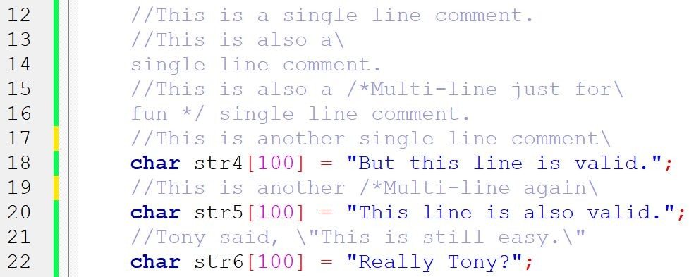
Assignment : Important Notes
Single line comments: anything after \ prevents the next line from being commented.

Slide 34
Assignment : Important Notes
Catch errors
12.1ef
12.efg
12abcd
‘\n
Keep track of line count and error count.
Your program should take a text file named ‘input.txt’ as input.

Slide 35
References
Flex & Bison by John Levine.
Book provided in Moodle.
Chapter 1 & 2
https://www.cs.princeton.edu/~appel/modern/c/software/flex/flex.html

